Slide 1

Dr. Sajid Iqbal
Department of Computer Science
Bahauddin Zakariya University, Multan

Slide 2
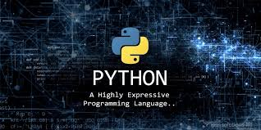

Introduction to Python
Introduction to computers

Slide 3
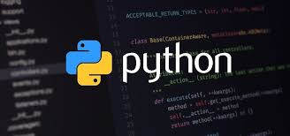

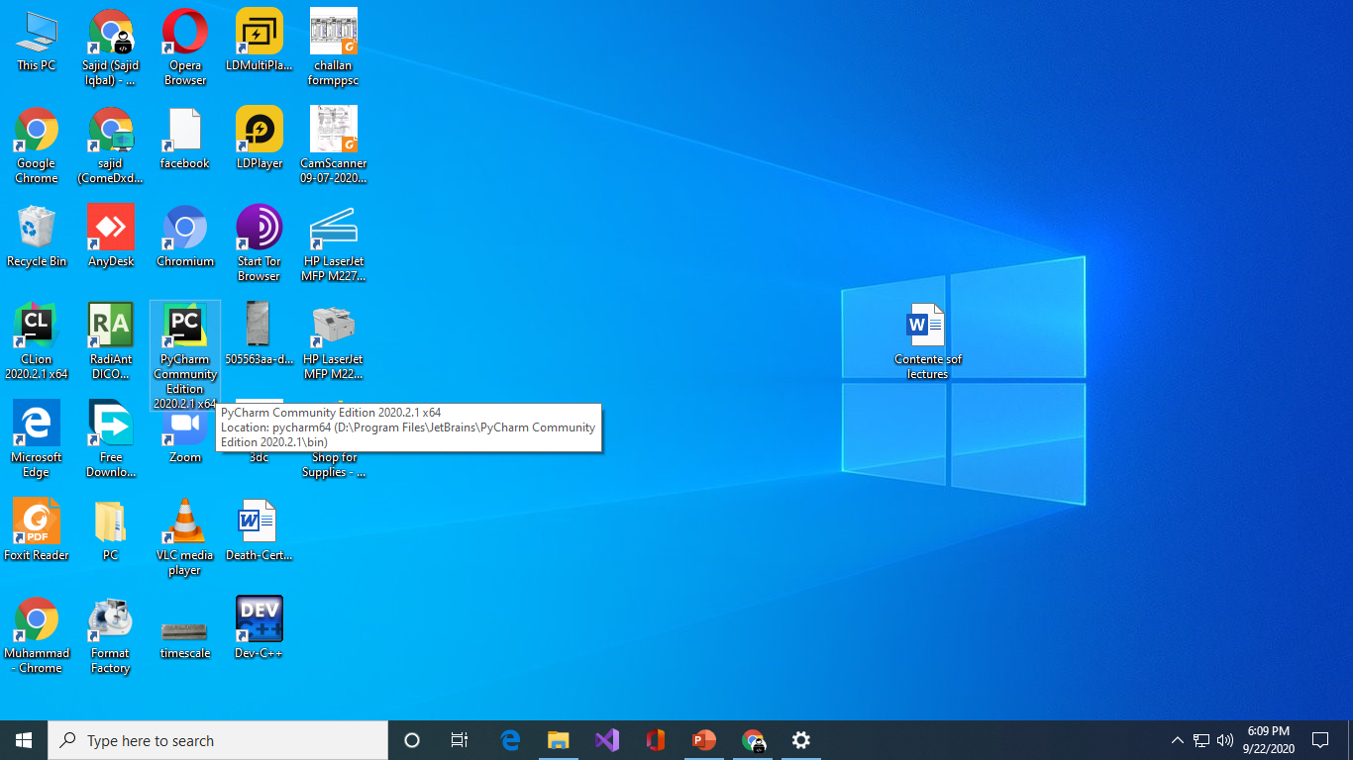
Some Syntactical Constructs
For this course, we will use
Computer Programming Language: Python
Source Code Editor: PyCharm community edition
There are number of tutorials that you can follow to install these software for example:
To install python: https://www.youtube.com/watch?v=UvcQlPZ8ecA
To install PyCharm: https://www.youtube.com/watch?v=EpjDOovzgrc
After successful installation, locate the icon of PyCharm on your desktop
Double click it to start the software

Slide 4
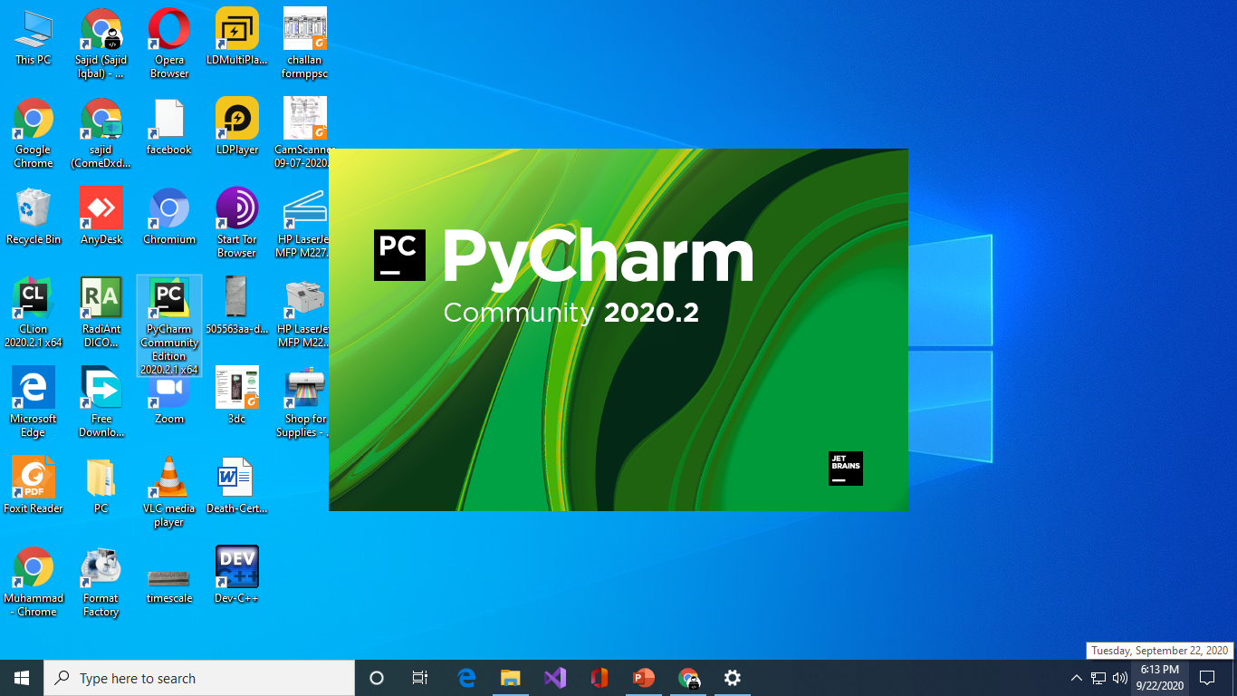
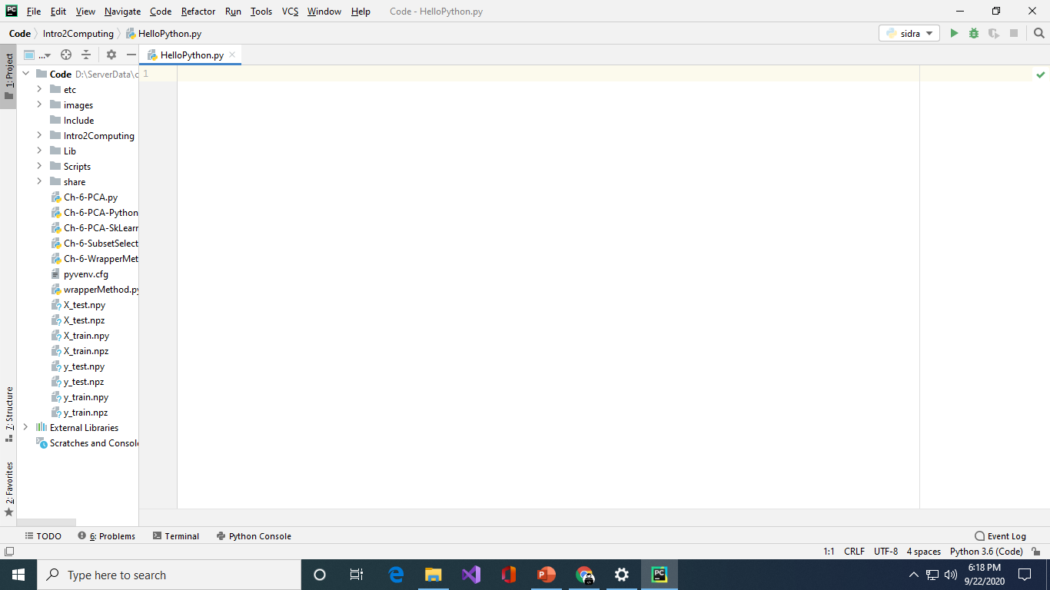
Creating your first project
Integrated Development Environment (IDE):
It is a software application that provides comprehensive facilities to computer programmers for software development
An IDE normally consists of at least
a source code editor,
build automation tools and
A debugger.
PyCharm is an IDE for python language programming
When you run the software, following loading screen is shown
Follow this YouTube video to start a new project
https://www.youtube.com/watch?v=YxHplztMQMc
Add a new python file in your project and name it as you like for example “helloPython.py”
You will get a blank file as shown
In this blank window you can write your software/instructions

Slide 5
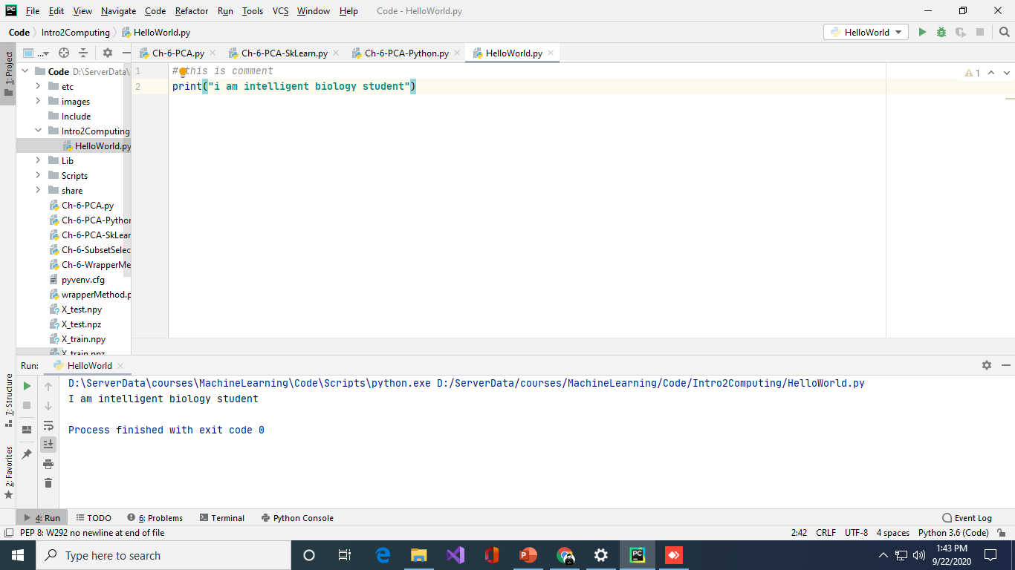
Another Program
Program run button
Project Files
Code Editor
Output Window

Slide 6

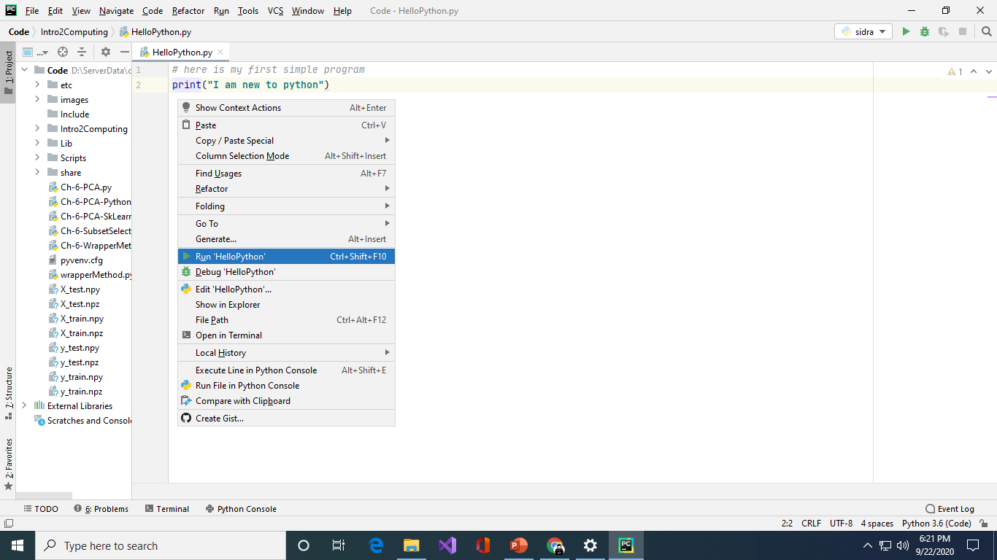
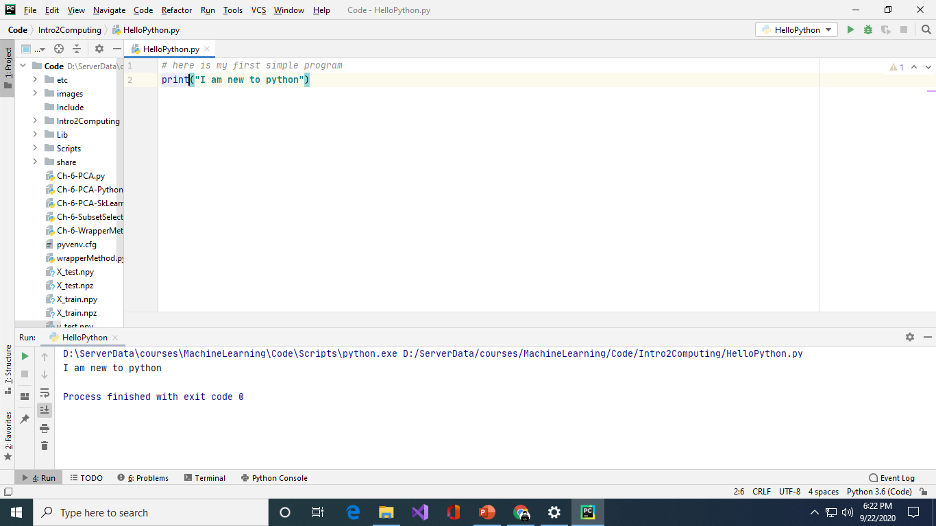
Writing first program
In blank window add following code
Right click in code editor and from pop up menu select Run ‘HelloPython”
The result will be shown in bottom output window

Slide 7
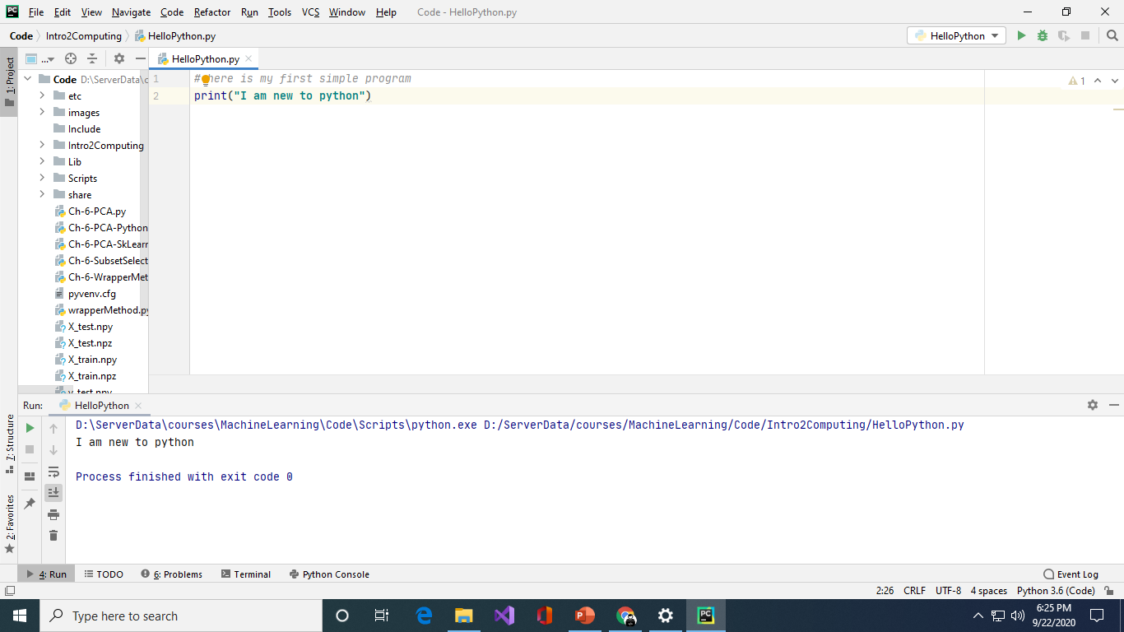
Printing in Python
Now we see some of language constructs
Comments
These are the English text or any thing which is written after # sign.
Comments are ignored by the compiler when running the program
These are the text that you write for your own self to understand the instructions
In this program, first line is comment which is not printed in output
Print statement
This statement is used to print something
If you want to print some text, write it in double quotes as shown

Slide 8
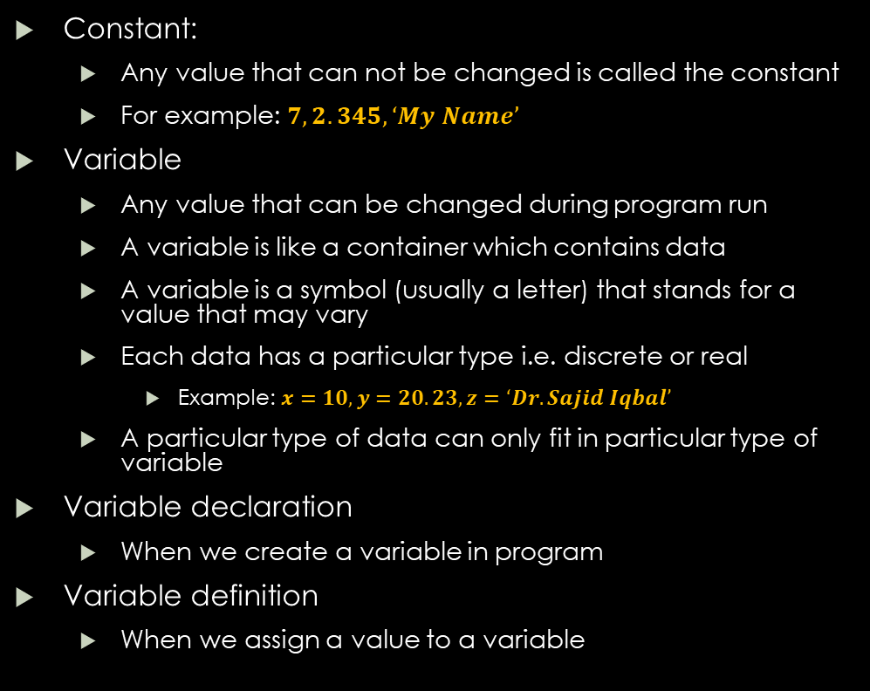
Constants and Variables
Constant:
Any value that can not be changed is called the constant
For example: $7, 2.345, ‘My Name’$
Variable
Any value that can be changed during program run
A variable is like a container which contains data
A variable is a symbol (usually a letter) that stands for a value that may vary
Each data has a particular type i.e. discrete or real
Example: $x=10, y=20.23, z=‘Dr. Sajid Iqbal’$
A particular type of data can only fit in particular type of variable
Variable declaration
When we create a variable in program
Variable definition
When we assign a value to a variable
Data
Variable
Variable
Data
Data
Variable
Data
Variable
data
Data

Slide 9
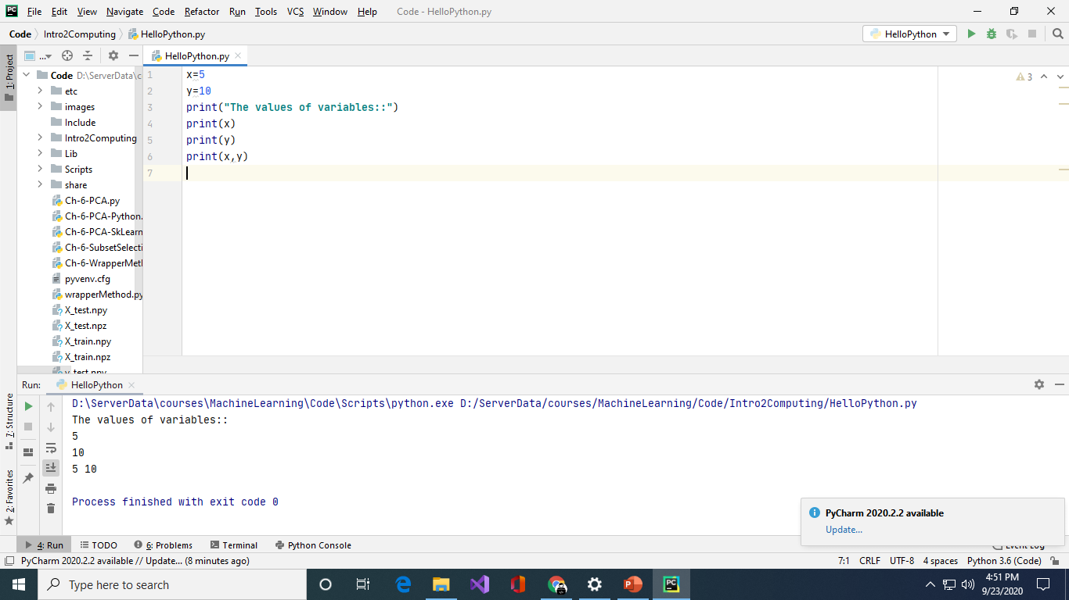
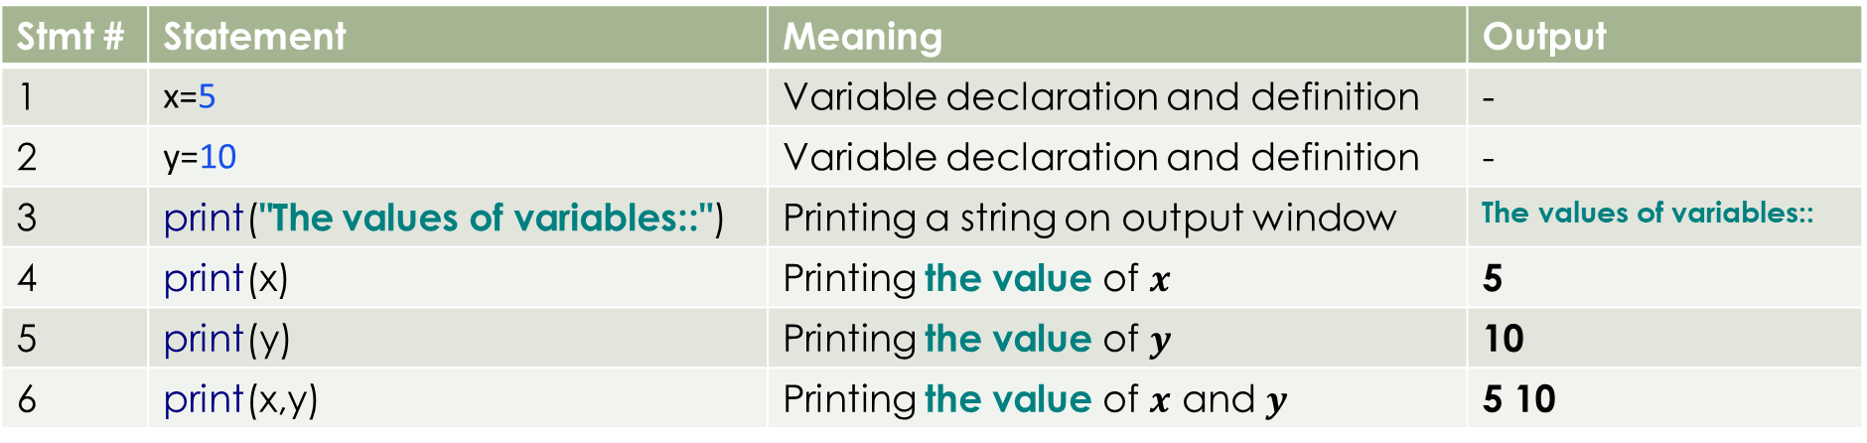
A Program Using Variables
Stmt # | Statement | Meaning | Output
1 | x=5 | Variable declaration and definition | -
2 | y=10 | Variable declaration and definition | -
3 | print("The values of variables::") | Printing a string on output window | The values of variables::
4 | print(x) | Printing the value of $x$ | 5
5 | print(y) | Printing the value of $y$ | 10
6 | print(x,y) | Printing the value of $x$ and $y$ | 5 10

Slide 10
Mathematical Expressions
The combination of numbers and variables in a valid way using operations like +, -
2+3
3*5
5*x
X+y
Y=3x+4y-6
….
S# | Statement | Meaning | Output
1 | x=5 | Assign value of 5 to x | -
2 | y=10 | Assign value of 10 to y | -
3 | print("The results are::") | Print the string | The results are
4 | print(2+3) | Print the result of addition expression of constants | 5
5 | print(5*4) | Print the result of multiplication expression of constants | 20
6 | print(2+3,5*4,4-3,6/3) | Print results of multiple expressions of constants | 5 20 1 2.0
7 | print(2+x) | Print result of mixed expression | 7
8 | print(y-6) | Print result of mixed expression | 4
9 | print(x+y) | Print result of expression of variables | 15
10 | print(x,y,x+y,x*y,y-6,8-x) | Print results of mixed multiple expressions | 5 10 15 50 4 3

Slide 11
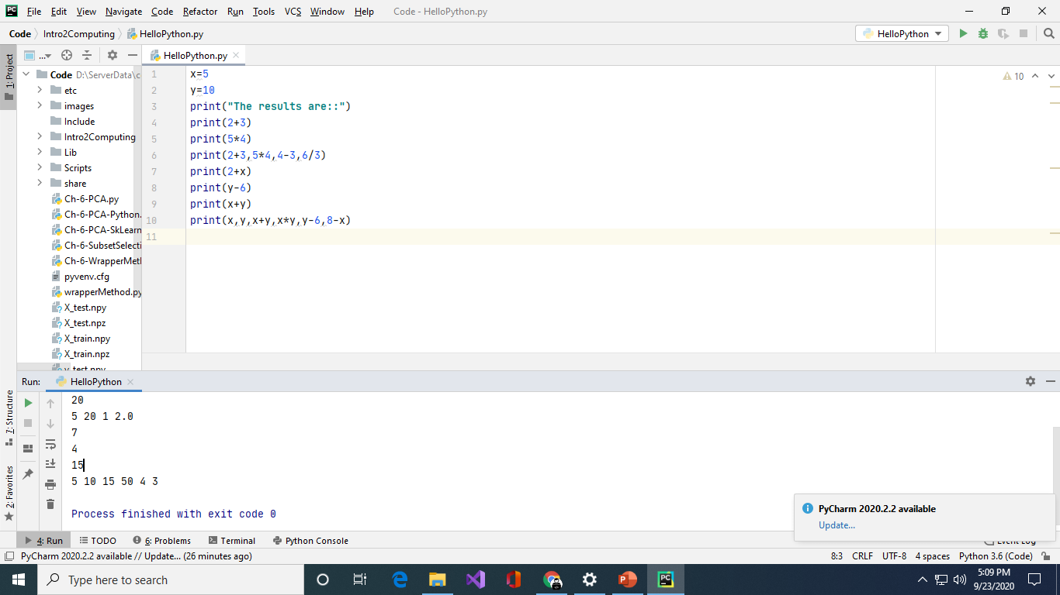
The Program and Results

Slide 12
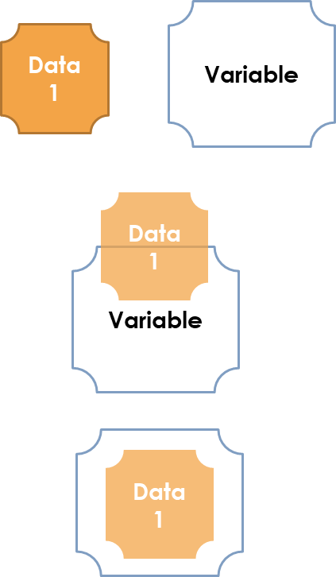
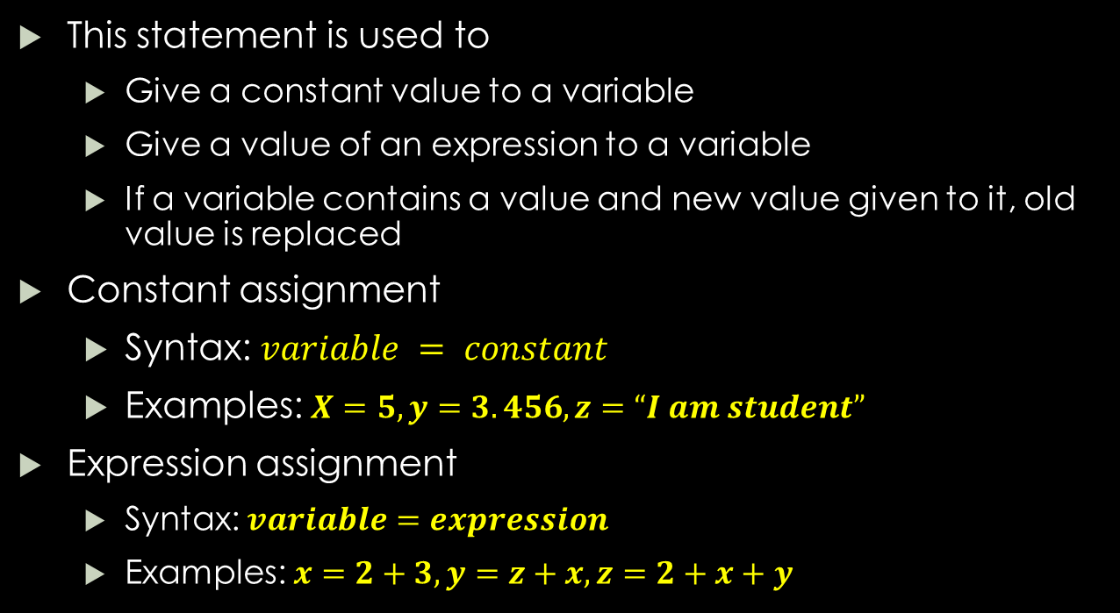
Assignment Statement
Variable
Data1
This statement is used to
Give a constant value to a variable
Give a value of an expression to a variable
If a variable contains a value and new value given to it, old value is replaced
Constant assignment
Syntax: $variable = constant$
Examples: $X=5, y=3.456, z=“I am student”$
Expression assignment
Syntax: $variable=expression$
Examples: $x=2+3, y=z+x, z=2+x+y$
Variable=data
Data2
Data1
Data2

Slide 13
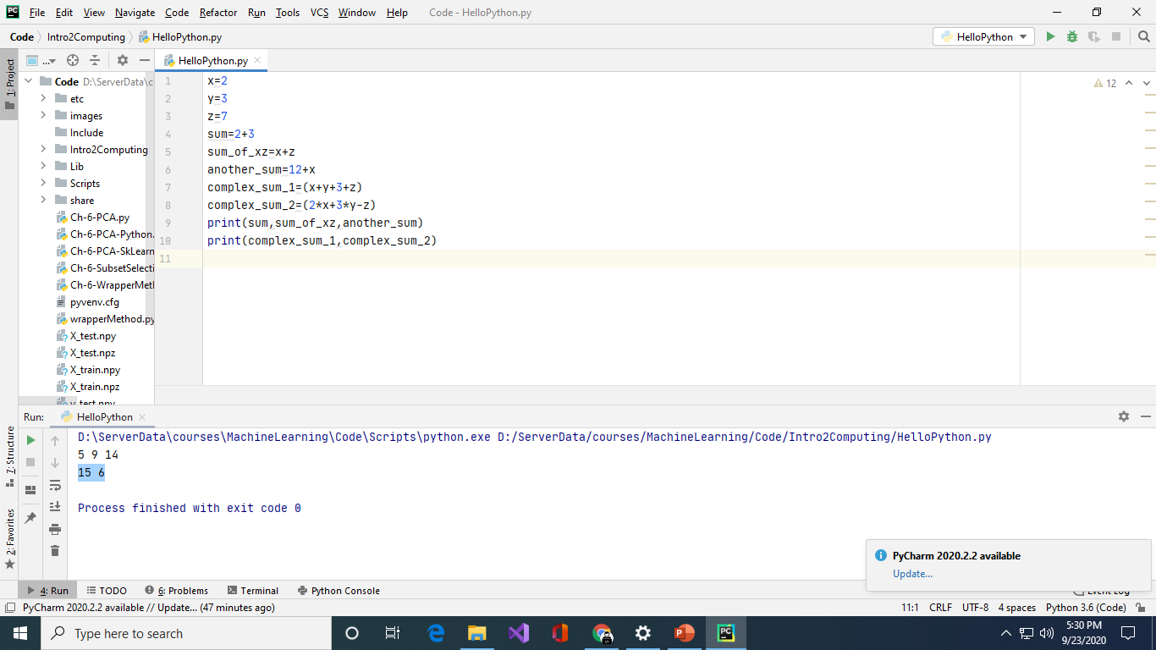
Program using assignment statement
S# | Statement | Meaning | Output
1 | x=2 | Give 2 to x | -
2 | y=3 | Give 3 to y | -
3 | z=7 | Give 7 to z | -
4 | sum=2+3 | Expression assignment | -
5 | sum_of_xz=x+z | Expression assignment | -
6 | another_sum=12+x | Expression assignment | -
7 | complex_sum_1=(x+y+3+z) | Expression assignment | -
8 | complex_sum_2=(2*x+3*y-z) | Expression assignment | -
9 | print(sum,sum_of_xz,another_sum) | Print values of variables | 5 9 14
10 | print(complex_sum_1,complex_sum_2) | Print values of variables | 15 6

Slide 14
Exercises
Write program to add two numbers
Write program to print your name
Write program to find square of two numbers
Write a program to find factorial of a number
Write a program to convert centimeters to meters
Write a program to convert meters to centimeters
Write a program to convert Celsius to Fahrenheit
Write a program to convert Fahrenheit to Celsius
Write a program to write a leave application
Write a program to write an email to your friend about your studies

Slide 15



Thanks for watching
Dr. Sajid Iqbal
Assistant Professor
Department of Computer Science
Bahauddin Zakariya University, Multan
sajidiqbal.pk@gmail.com
https://github.com/sajjo79/Introduction-to-Computers
Allah Hafiz
COMEDXD

